Slide 1

ECS Modular Unit Design
In Unity 2019.2

Slide 2
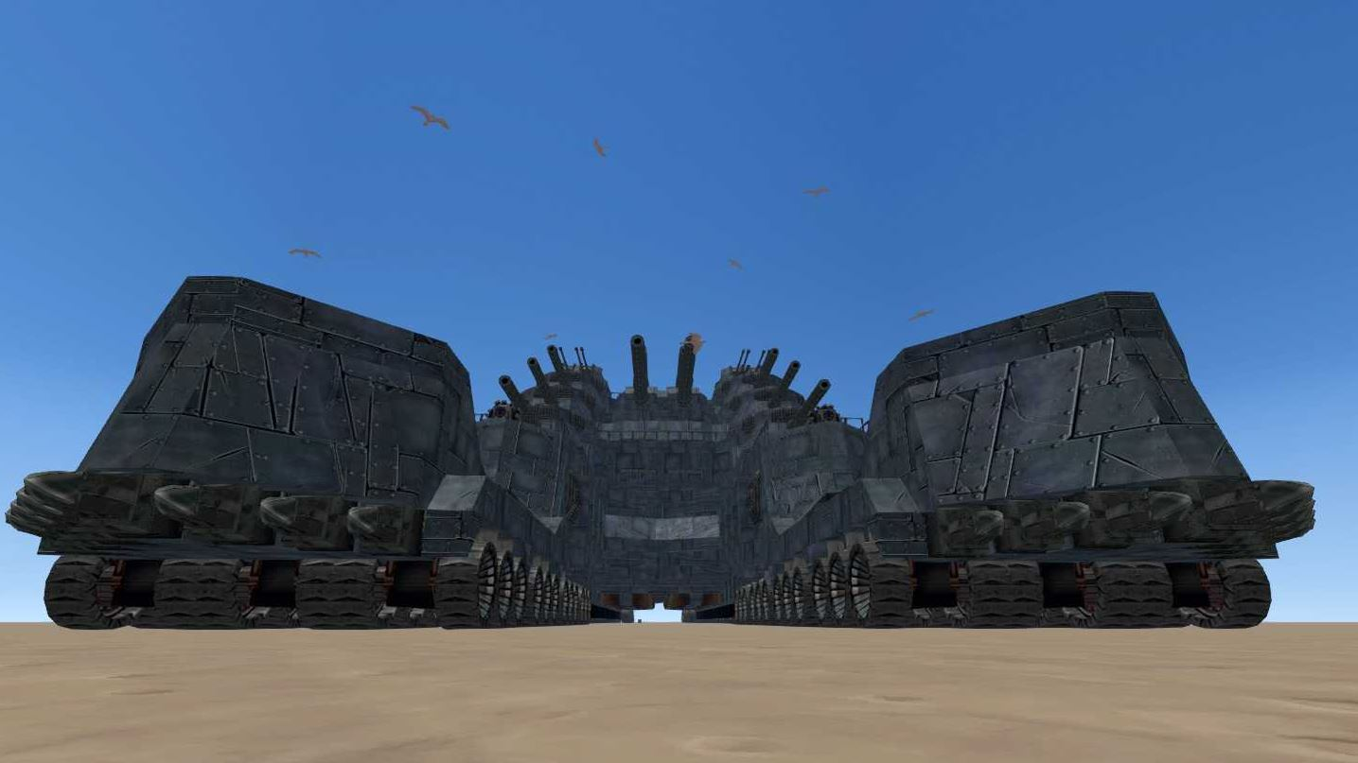

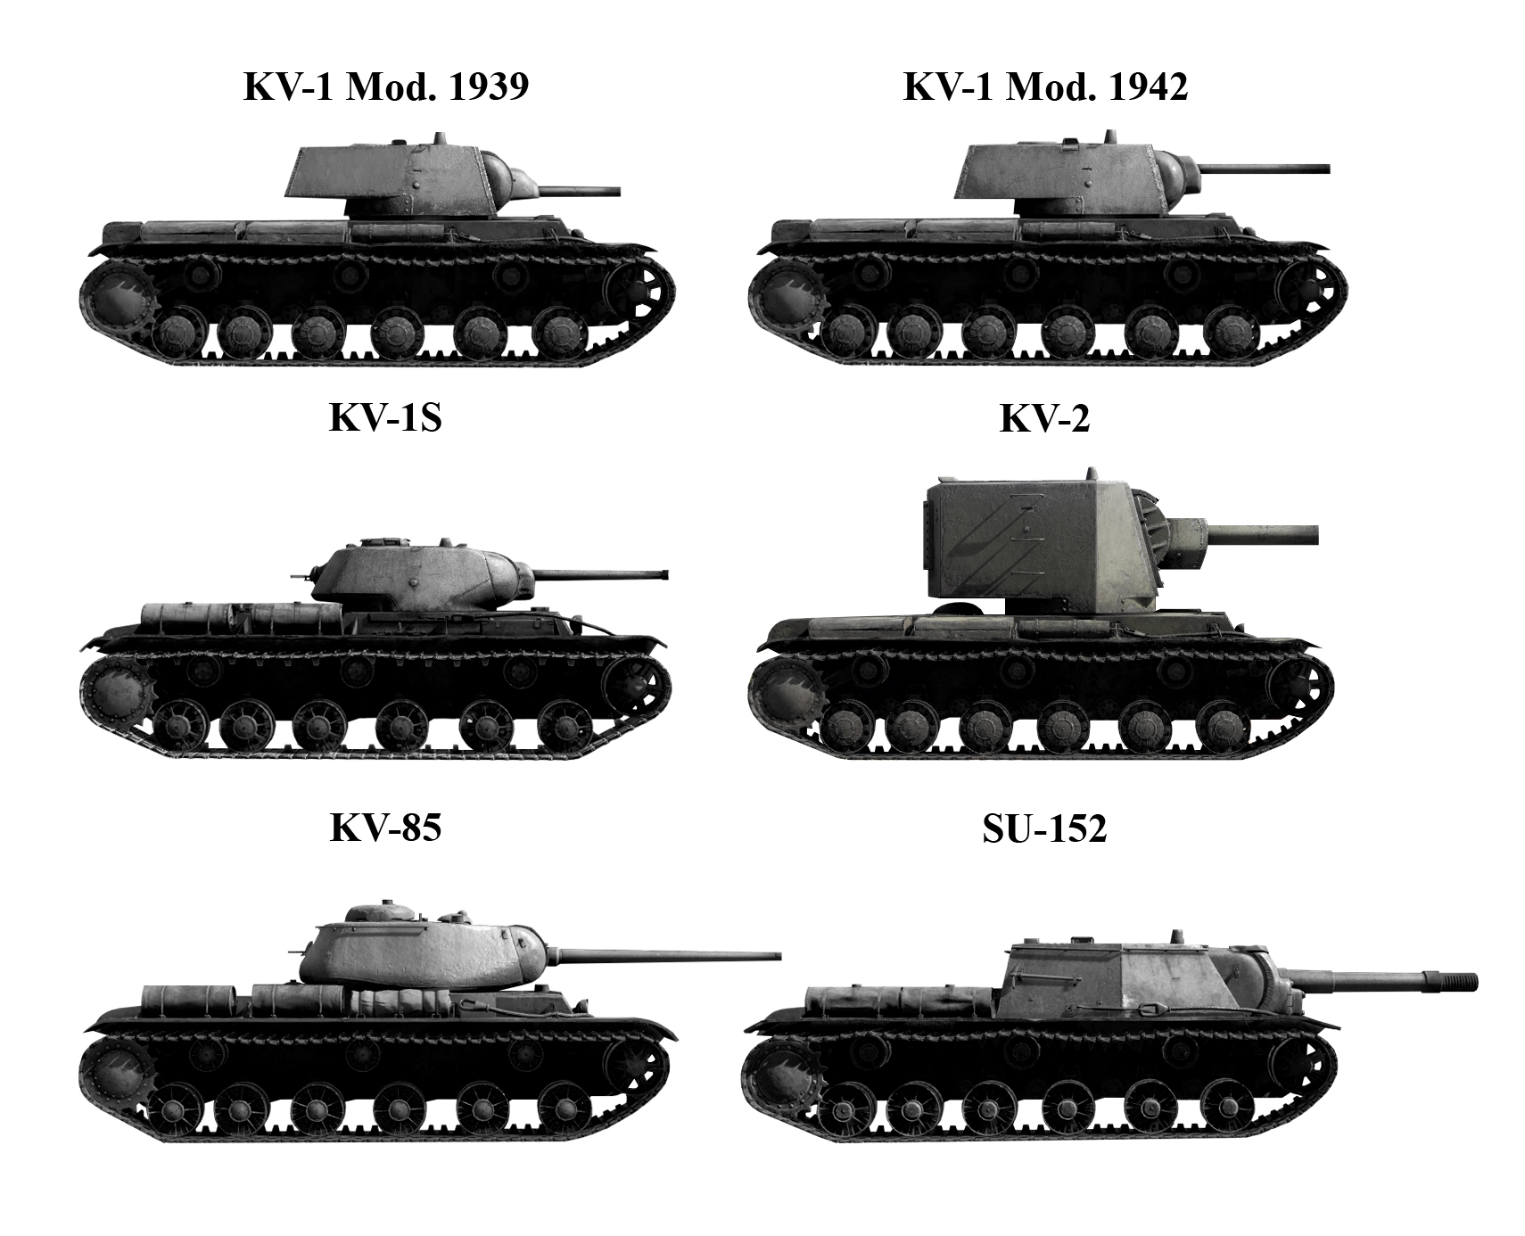
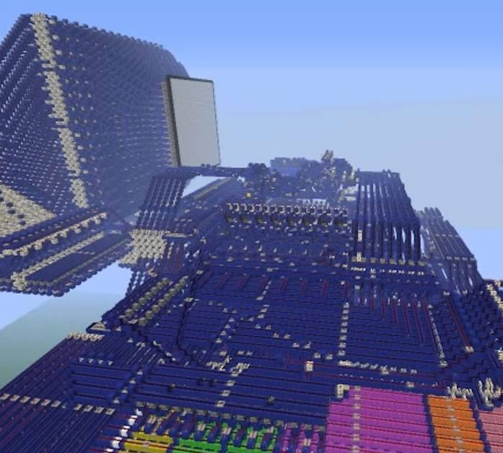
Motivations
Sandbox
Realism
Performances
(­Balance ?)

Slide 3
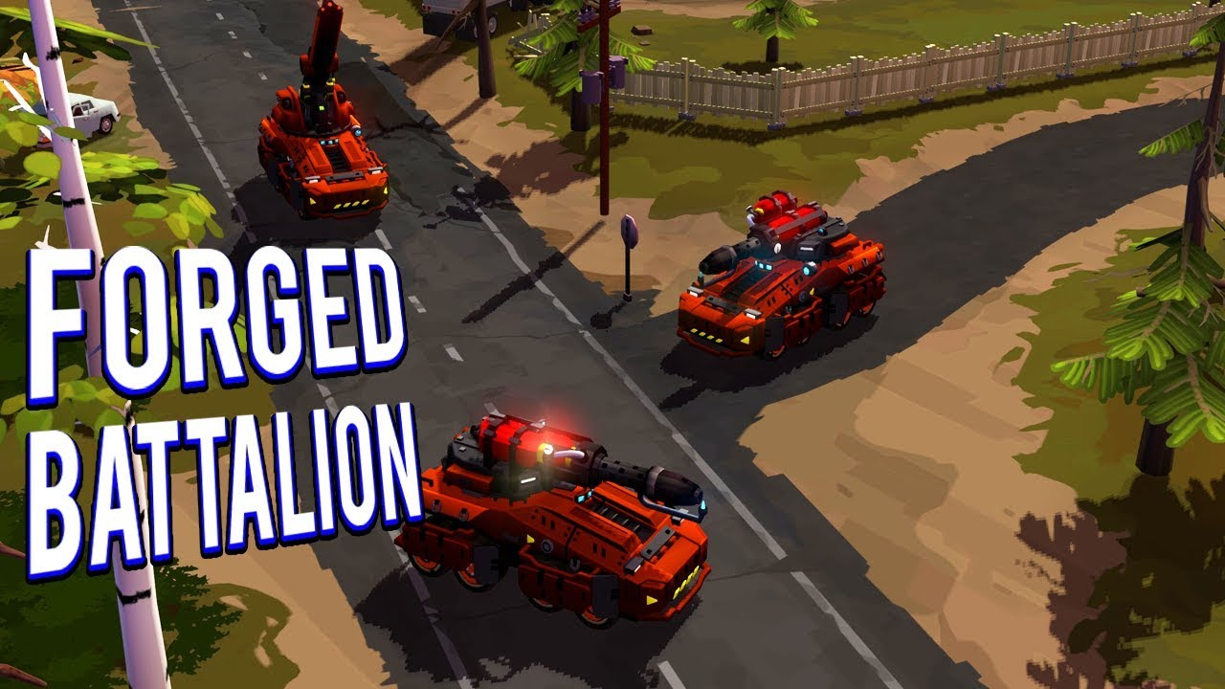
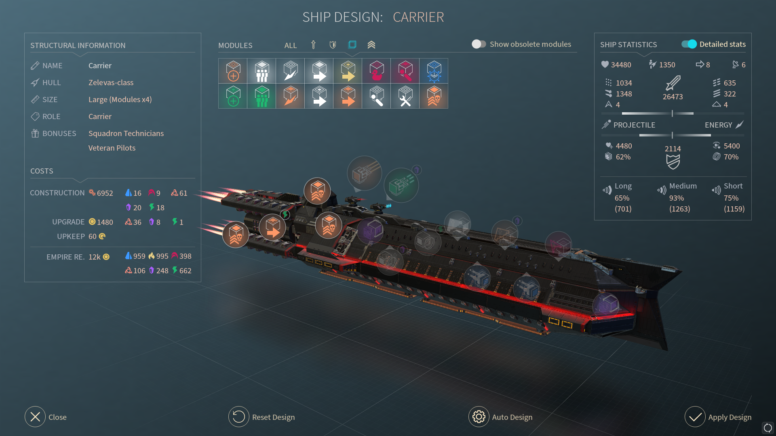
Objectives
Customizable Units
Unit Design Tools
ECS Result

Slide 4
Tools
Unity Engine 2019.2
Unity’s DOTS (0.1.1)
Probuilder & Progrids

Slide 5
Problems
Accessible Serialization
Initialization
OOP to ECS

Slide 6
Serialization
XML / Json / Scriptables
Handle Modifications
Incomplete Units

Slide 7
Initialization
Load Save Files
Lightweight Instantiation
OOP XML → ECS Unit

Slide 8

OOP - ECS
Configure Behaviors
Structure Mismatch
Merging Assets

Slide 9
Presentation

Slide 10
Thanks

